Slide 1

Location for new Retail Business London Borough Analysis
United KINDOM
by Magdalena Cieslak

Slide 2
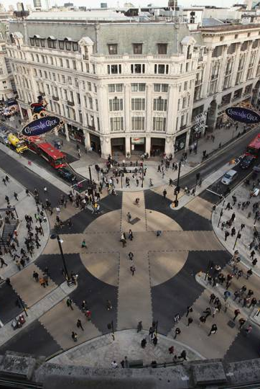
1. A description of the problem and a discussion of the background. London is one of the biggest city in Europe. Population 7.9 million on area 592.43 sq./mi. This city is attracting domestic and international investors. Analysis is for customers who planning open retails store and would like to know area better. I am planning to provide data for 32 London Boroughs about: area, population, earnings, domestic visitors spend and oversea visitor spend. I will also count correlation between them In second part I will get information about venues and categories. Then I will select venues related to retail. Finally I will form borough cluster for retail venue .
2. A description of the data and how it will be used to solve the problem.
Scraping London Borough data from Wikipedia website https://en.wikipedia.org/wiki/List_of_London_boroughs
Obtain csv. File of earnings & tourist data from government website
https://data.london.gov.uk/dataset/tourism-spend-estimates
https://data.london.gov.uk/dataset/earnings-workplace-borough
Problem: unable to find specific borough latitude and longitude file. Problem solution create own csv. File on base of Geo names organisation website https://www.geonames.org/
Collecting information about Venus using Foursquare API
Create locations and clusters map

